Slide 1


Social
Buzz
Prepared By-
Jaymeen Jethva

Slide 2


Today's agenda
Project recap
Problem
Process
Insights
Summary

Slide 3


Social Buzz is a fast growing technology union
That need to adapt quickly to it's global scale.
Accenture has begun 3 month POC focusing in
These tasks:
An audit of Social Buzz's big data practice
Recommendations for successful IPO
Analysis to find Social Buzz's top 5 most
popular categories of content
Project Recap

Slide 4


Problem
Over 100000 posts per day
36,500,000 pieces of content
Per year !
But how to capitalize on it when there is so much?
Analysis to find Social Buzz's top 5 most popular
categories of content

Slide 5

Process
1
Data Understanding
2
Data Cleaning
3
Data Modelling
4
Data Analysis
5
Uncover Insights

Slide 6


Insights
16
Animal
January
Most popular category
Month with highest number of posts
Unique Categories

Slide 7
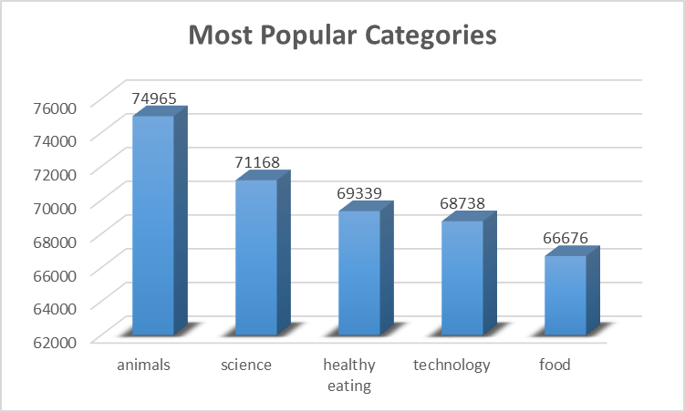

Slide 8
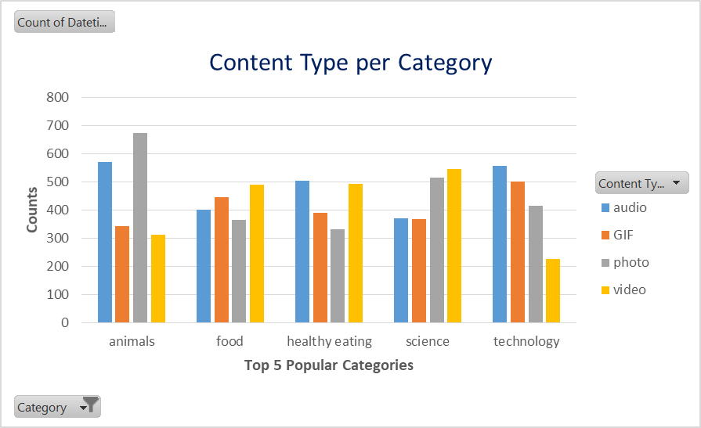

Slide 9
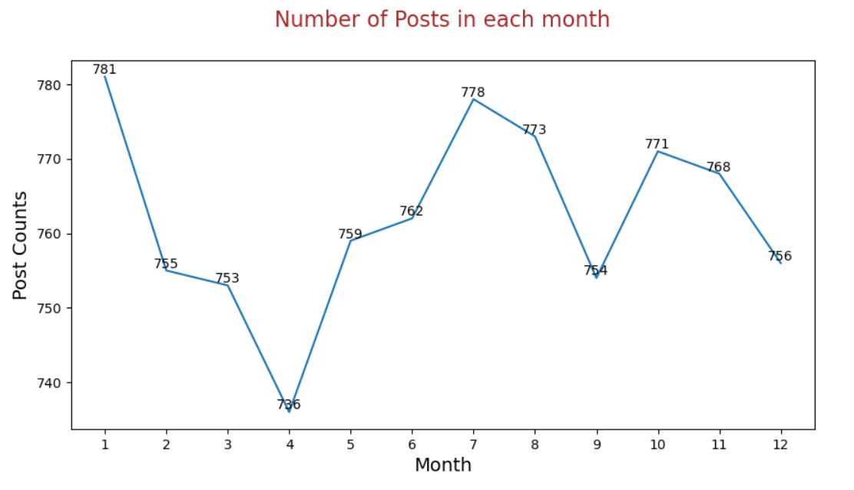

Slide 10

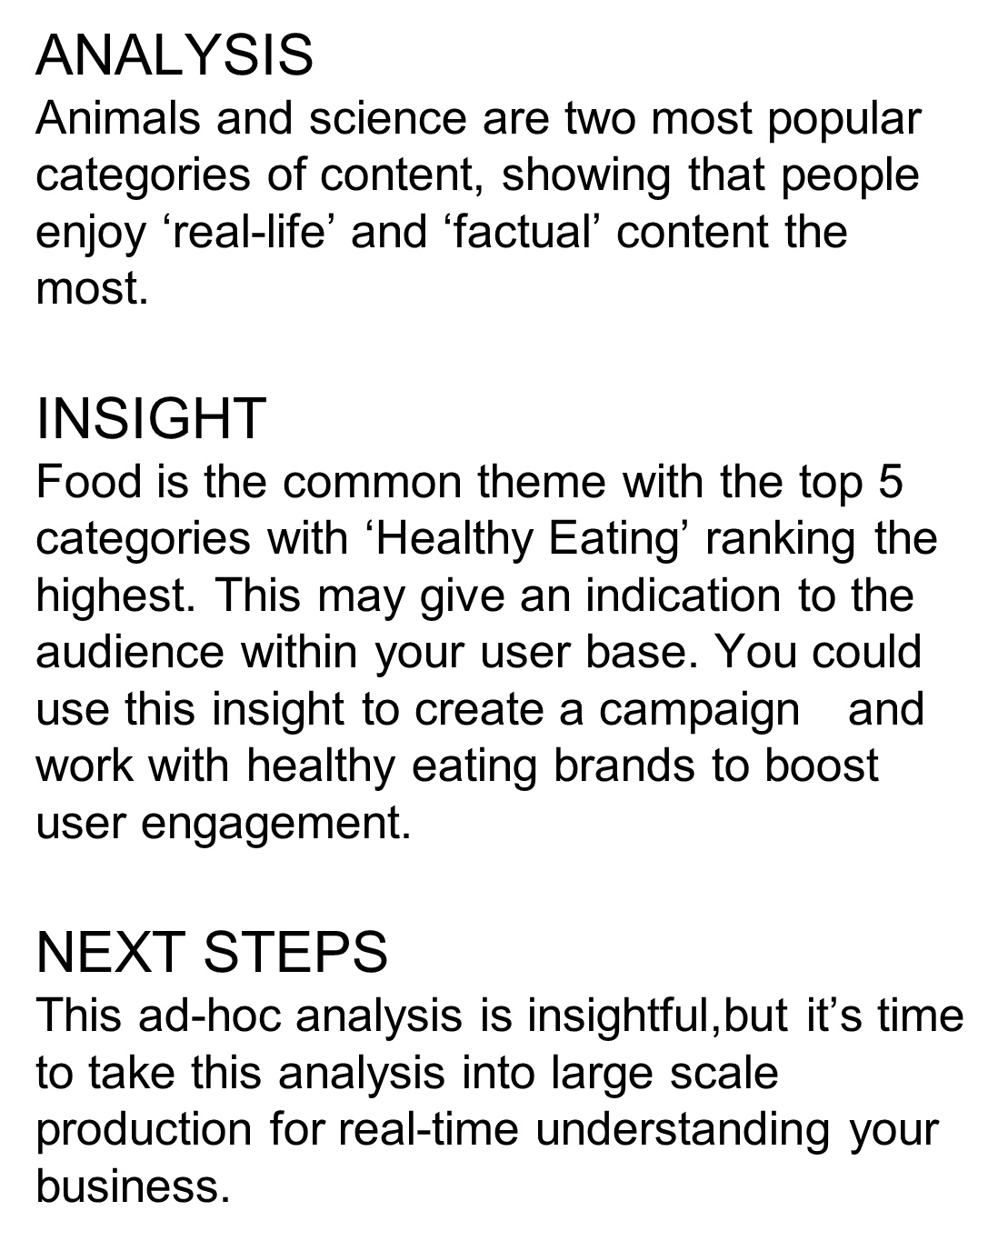

Summary

Slide 11

Thank you!
ANY QUESTIONS?

